Slide 1
Regulation of gene expression
What is gene regulation and why it is required?
A single human cell contains over 100000 different genes. Yet only a fraction of those genes are expressed in any one cell at a given time.
Gene regulation refers to the ability of cells to determine which genes should be expressed, when those genes should be expressed and the extent to which each gene should be expressed.
Potential control points where gene expression can be turned on or off, speed up or slowed down
The cells of all multicellular organisms are specialized to perform the specific functions of the tissues in which they reside.
Differential gene expression
At any given time, a typical human cell expresses about 20% of its genes.

Slide 2
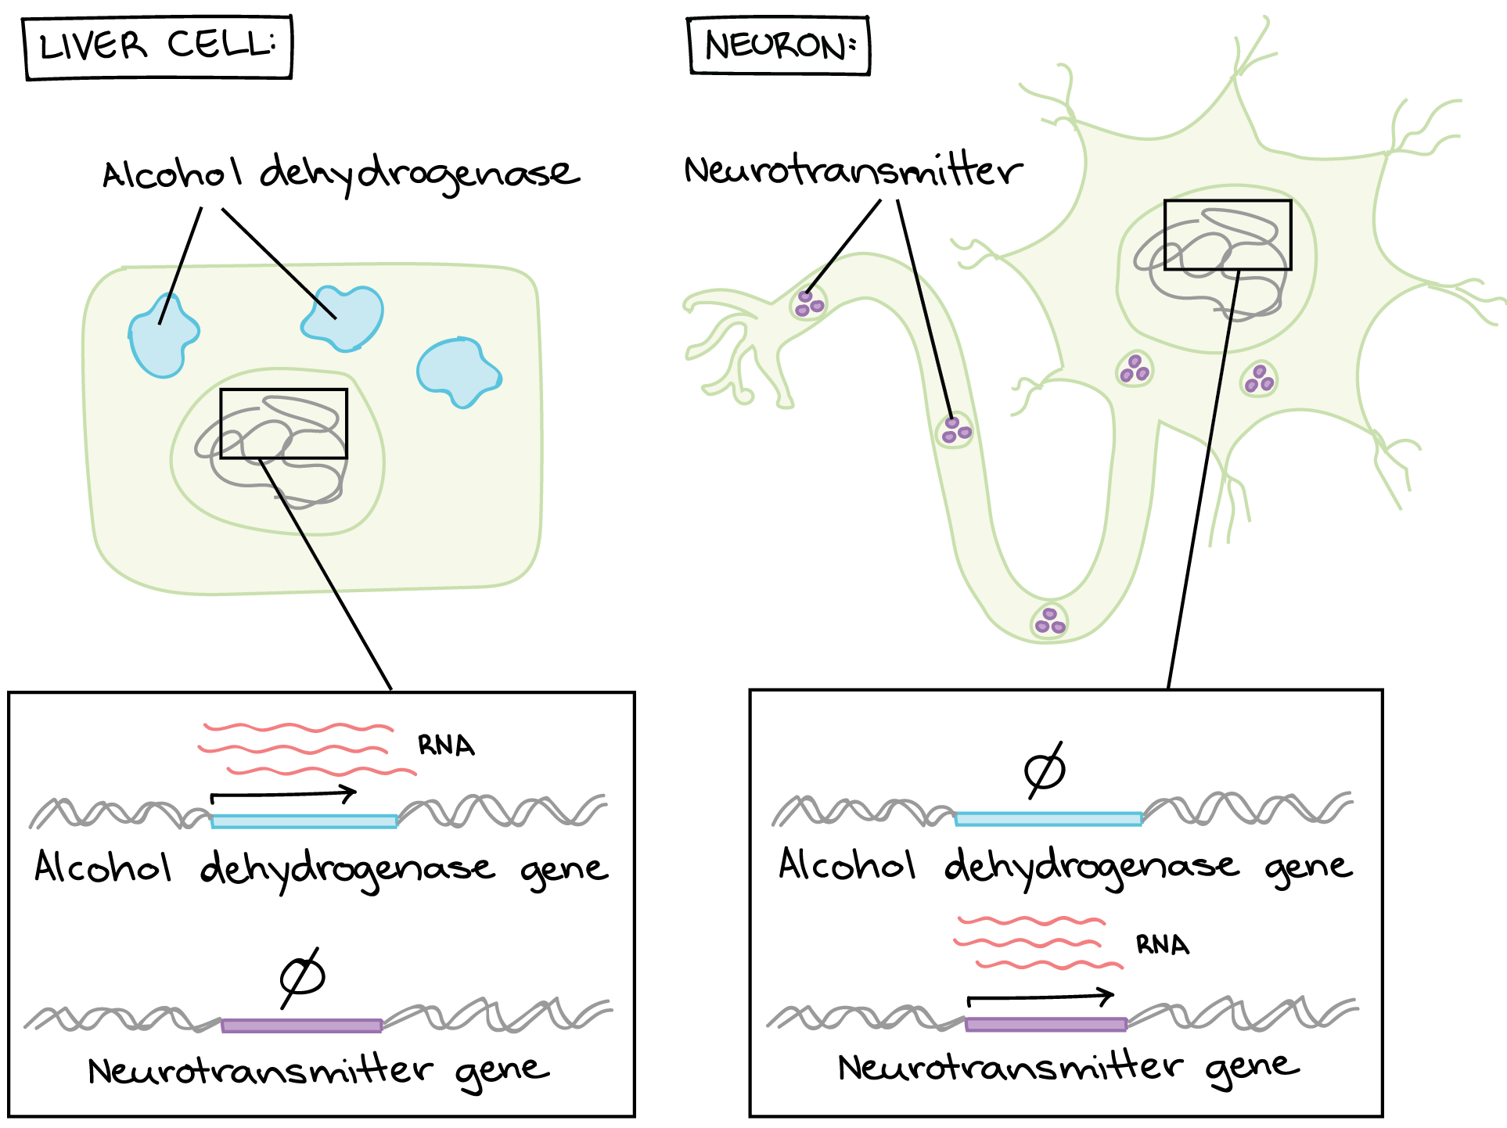
Enzyme alcohol dehydrogenase is expressed in liver cell, but expression of neurotransmitter gene is switched off. However, in neurons, dehydrogenase enzyme expression is switched off, but neurotransmitter genes are expressed.

Slide 3
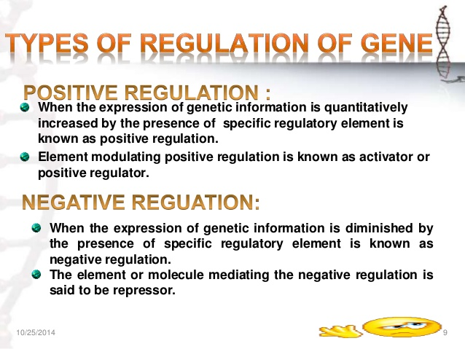
The regulation of gene expression is necessary for the growth, development, differentiation and existence of organism.

Slide 4
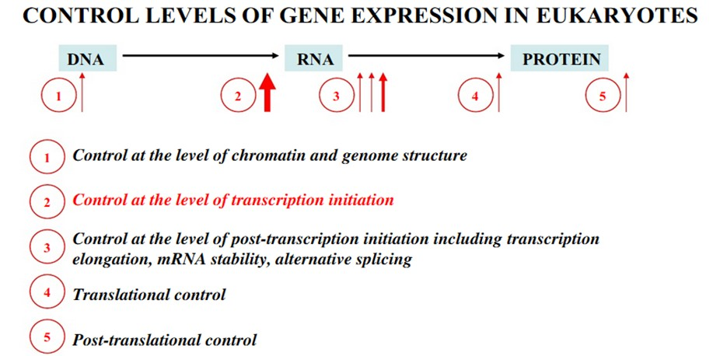
Gene regulation
Gene regulation at chromatin level
Transcriptional regulation
Post-transcriptional regulation
Translational regulation
Post-translational regulation

Slide 5
Five levels of gene regulation
Potential control points where gene expression can be turned on or off, speed up or slowed down
Chromatin remodeling: the region of DNA must be opened for enzymes and transcription factors to access the gene. DNA is wrapped in nucleosomes (histone proteins + DNA complexes) and known as chromatin. Histone proteins undergo modifications for opening of DNA for transcription of genes.
Transcriptional regulation: Determination of whether or not, and to what extent, a gene will be transcribed.
Post-transcriptional regulation: Regulation of the processing, transport, and longevity of mRNAs. In eukaryotes this level includes regulation of the rate and extent of processing pre-mRNA into mature mRNA, the transport of mRNA into the cytoplasm and the rate of degradation.
Translational regulation: Determination of whether mRNA will be translated or not and extent of translation.
Post-translational regulation: Regulation of protein modification and activity (includes modification of inactive protein to form active protein)

Slide 6
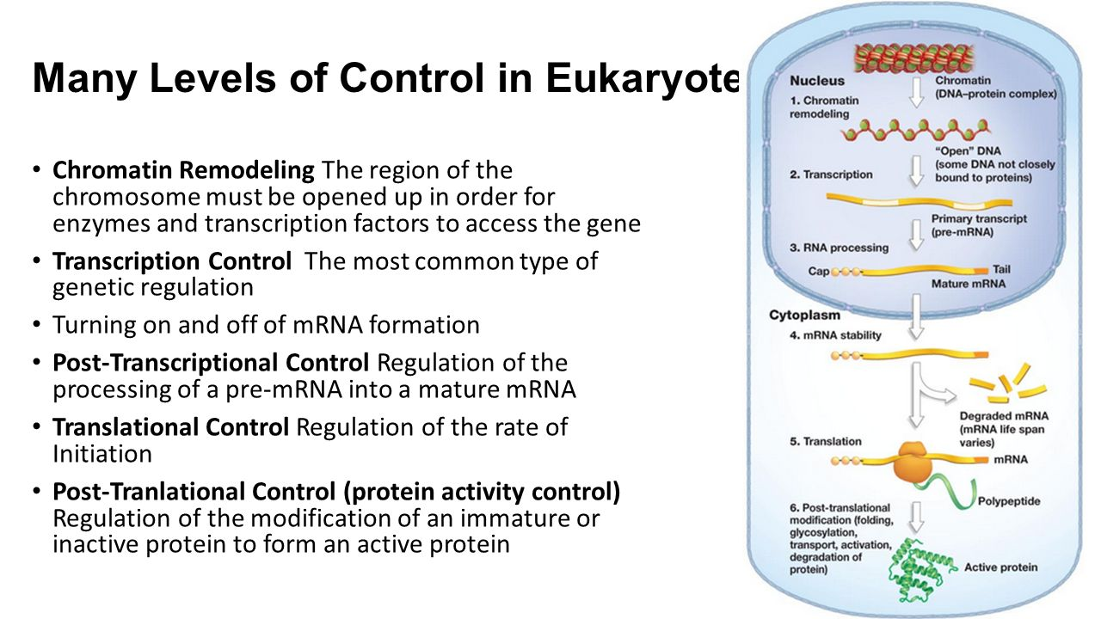
DNA wrapped in histones and called as chromatin fibres
Gene regulation at chromatin level
Transcriptional regulation
Post-transcriptional regulation
Translational regulation
Post-translational regulation

Slide 7
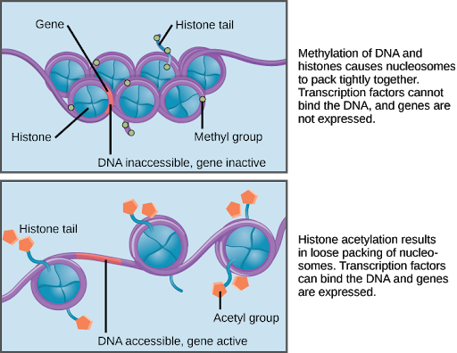
1. Gene regulation at chromatin level
Methylation of histones – genes are not expressed as genes are inaccessible by transcription factors.
Acetylation of histones – genes are expressed by easy accessibility of genes by transcription factors.

Slide 8
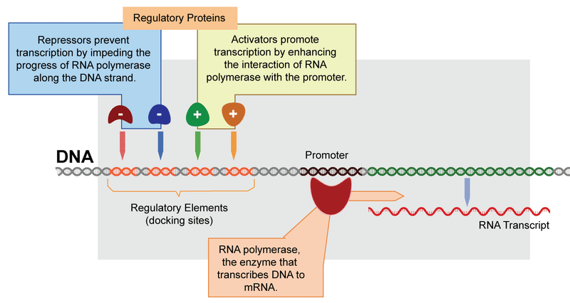
Transcriptional gene regulation and its components
2. Transcriptional regulation
Repressors: are transcription factors that has a DNA-binding domain, which interacts with specific DNA sequences, and a repressor domain, which interacts with other proteins (regulatory proteins to repress the transcription).
Activators: are transcription factors that has a DNA-binding domain, which interacts with specific DNA sequences, and an activation domain, which interacts with other proteins to stimulate transcription from a nearby promoter.
Regulatory proteins, repressors, activators in transcriptional regulation

Slide 9
3. Post-transcriptional gene regulation
Regulation of the processing, transport, and longevity of mRNAs.
In eukaryotes, this level includes regulation of the
Rate and extent of processing of pre-mRNA into mature mRNA,
Pre-mRNA processing to mRNA: 5’-capping; polyadenylation, splicing (removal of introns)
2. Alternative splicing in nucleus
3. Rate of degradation of mRNA
Stability of mRNA in the cytoplasm

Slide 10
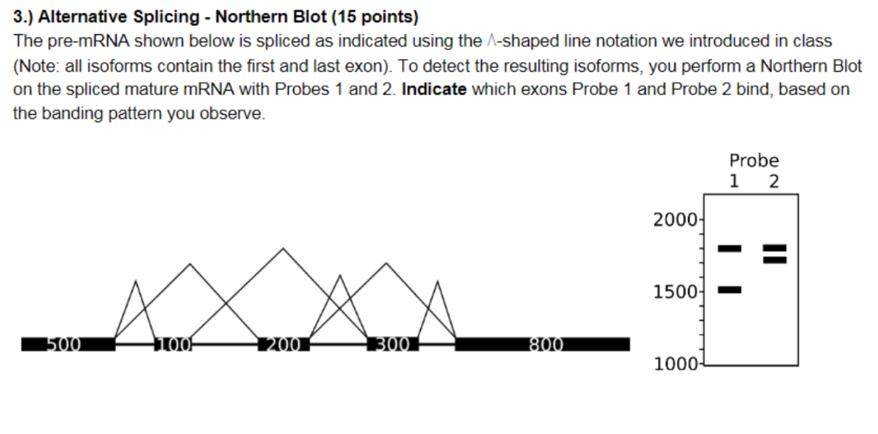
Post-transcriptional gene regulation
Alternative splicing in nucleus
Stability of mRNA in the cytoplasm
Alternative splicing: In this process, pre-mRNAs that are formed after transcription, undergoes alternative splicing of introns to form functional and mature mRNA. This processing permits the synthesis of different versions of protein.
Pre-mRNA
Exons joining
Intron's removal
Joining of 500+100+300+800 = 1700 bases
Joining of 500+200+800 = 1500 bases
Joining of 500+200+300+800 =1800 bases
Removal of 200 base (exon) with intron
Removal of 100 and 300 base exon with intron
Removal of 100 base exon with intron

Slide 11
Stability of specific mRNA in the cytoplasm
Some mRNAs are unstable and have a very short life span in the cytoplasm, whereas others may be much more stable, permitting them to be translated many times.
The production of a gene product may be regulated by altering the stability of a specific mRNA.
For example, the production of casein, an abundant protein in milk.
The hormone Prolactin, increases the stability of mRNAs that encode casein, causing increased translation of casein when prolactin is present.

Slide 12
4. Regulation at the level of translation
In translational control, regulators select which mRNAs in the cytoplasm will go for translation by ribosomes
Mechanisms of translational control:
Transport control: only the mRNA which is transported to the cytoplasm can be translated.
Number of ribosomes
Translational factors: If the concentration of these factors is too low in the cell, the translation start, or the elongation process can be inhibited.
Regulation by untranslated region of mRNA.

Slide 13
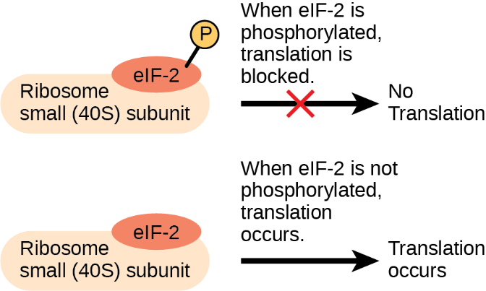
Translational control involved initiation factors that bind the translation initiation complex.
An increase in phosphorylation levels of eIF-2 has been observed in patients with neurodegenerative diseases such as Alzheimer’s, Parkinson’s, and Huntington’s

Slide 14
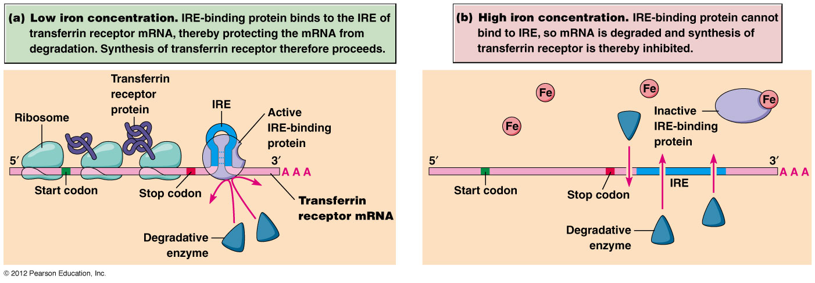
Example of translation control by regulation of untranslated region of mRNA- Synthesis of transferrin receptor for controlling the iron concentration in the cell.
IRE- iron response elements and IRE-binding proteins

Slide 15
5. Post translational regulation
Post translational regulation refers to the control of levels of active protein. It is performed by means of reversible events such as posttranslational modifications and irreversible events such as proteolysis.
Chemical modifications of proteins after its translation is called post translational modifications. The chemical modifications that takes place at certain amino acid residues after the protein is synthesized.
Mostly occurs in endoplasmic reticulum and golgi apparatus.
Importance of post translational modifications include:
Stability of proteins
Generating heterogeneity in proteins
Help in utilizing identical proteins for different cellular functions in different cell types
Translocation of proteins across biological membranes to their target location for activity, in cell signalling interactions
Contribute towards biological processes and diseased conditions.

Slide 16
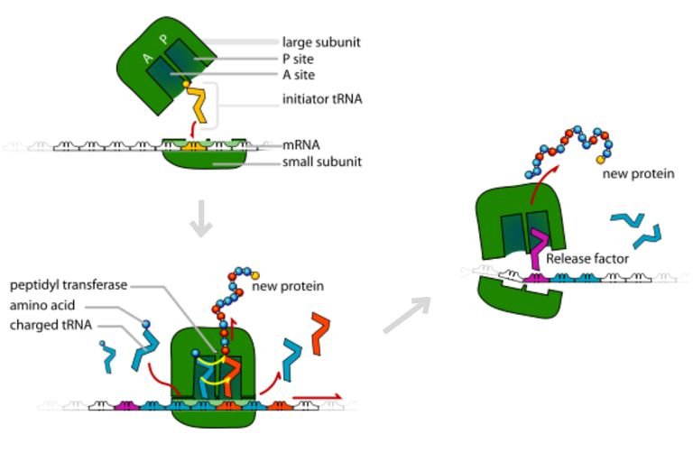
2. Completion of Translation process
1. Translation process-decoding the codon message into polypeptide formation
6. Active protein targeted to Specific location for carrying out biological functions
3. Inactive newly synthesized protein released from translational machinery
4. After post translational modifications, attachment of chemical groups, conformational changes and folding
5. Active and functional protein after post translational modifications

Slide 17
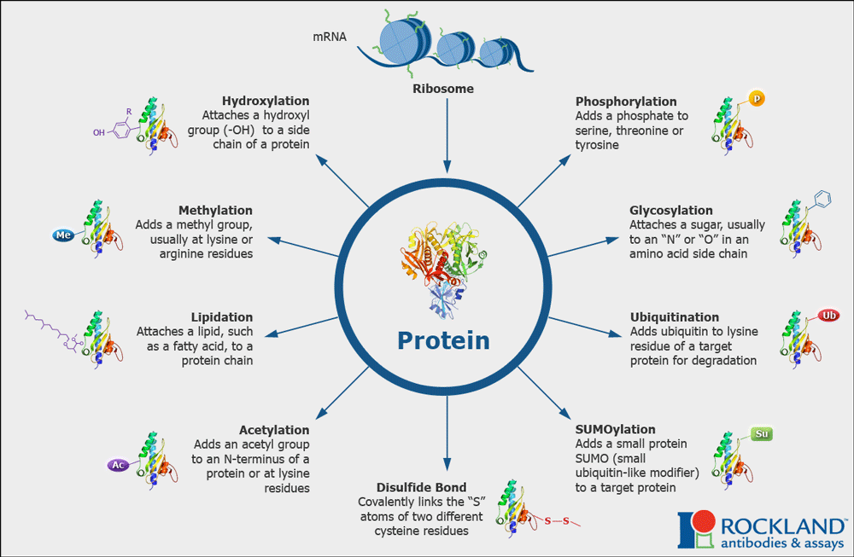
Attachment of chemical groups as post translational modifications
Pro, Lys
Ser, Thr, Tyr
Asn, Thr, Ser
Lys

Slide 18
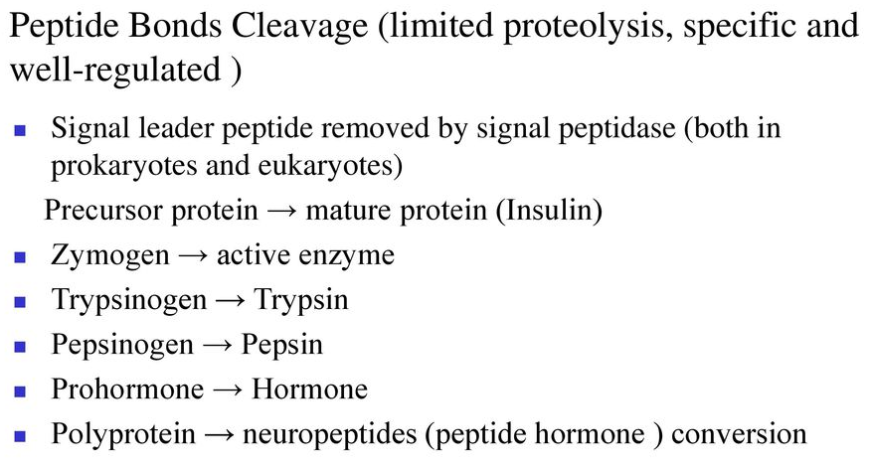
Post translational regulation as a modification involving peptide bonds cleavage (limited proteolysis)

